Slide 1
Comparch GPU Final Slides
Adi Tolu Patrick
Notes:
We plan to find out the circumstances around and at what point exactly the need arose for a separate computational architecture to handle intensive graphics processing. We plan to study the architectural similarities and different design constraints of a GPU and CPU, and make sense of common GPU technologies and jargon not easily understood by the layman

Slide 2
Let’s review
CPU purpose
CPU architecture

Slide 3
WHAT’S ITS PURPOSE
Managing the computer's memory
Handling input from users
Doing whatever calculations are necessary.
Sending them the necessary output
Cycle repeats
Let’s review the top-down level...

Slide 4
CPU PURPOSE & EXECUTION
Fetch instruction from memory
Decode instruction into actions/controls
Fetch/ Decode operands
Compute result value or status
Push result to storage
Determine next instruction
INSTRUCTION FETCH
INSTRUCTION DECODE
OPERAND FETCH
EXECUTE
RESULT STORE
SINGLE CYCLE

Slide 5
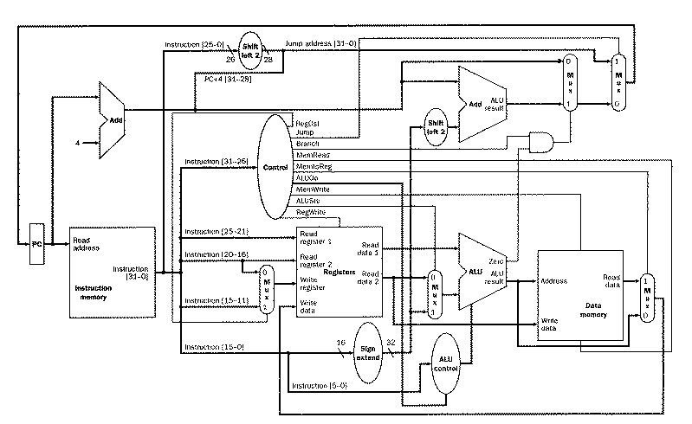
BASIC MIPS ARCHITECTURE

Slide 6
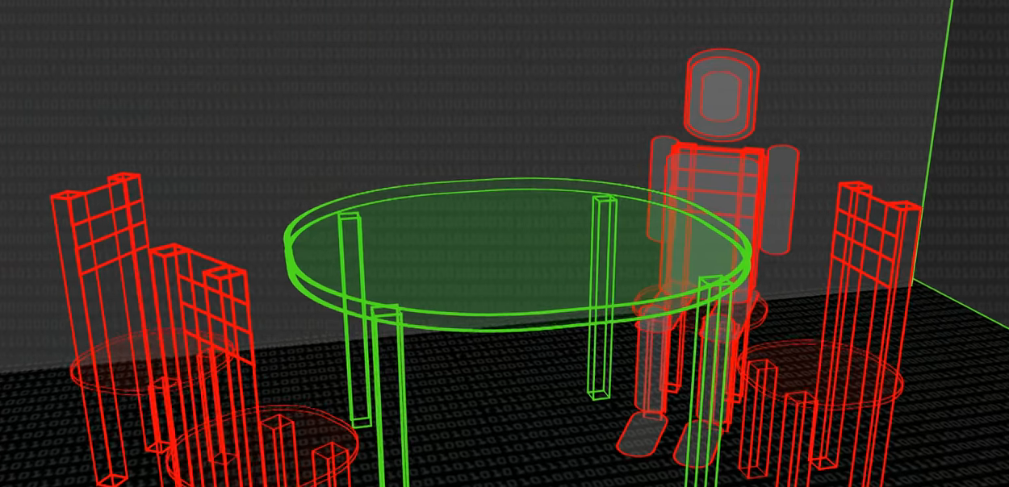
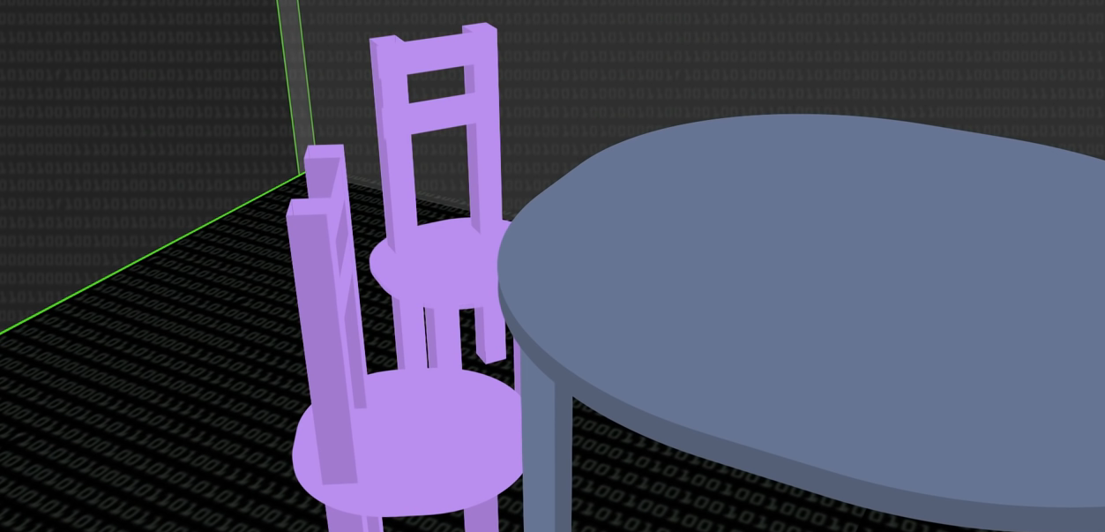
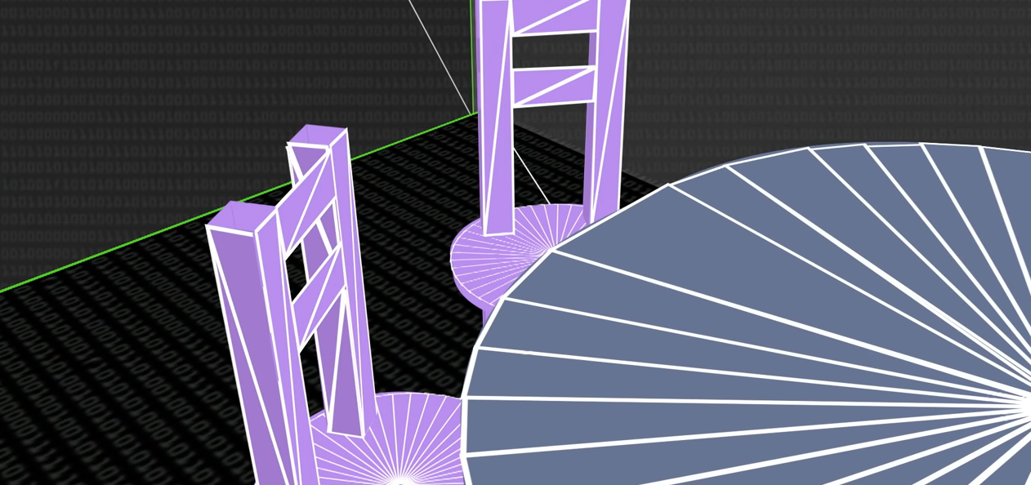

GPU’s purpose
Let’s render a scene of 3D models. We have to account for →
positions of the 3D models ( a table, chairs, person)
Textures (AKA color)
geometry, camera positioning (what we actually see)
Light (alterations of color)
A GPU is given this list of these 4 operations for n pixels (in the millions).
The trick is to be clever about parallelizing these 4n operations to compute with an appropriate throughput.
2)
3)
4)
Notes:
A GPU is basically a collection of parallelized cores which perform operations on a bunch of data which in which its operations can be parallelized

Slide 7
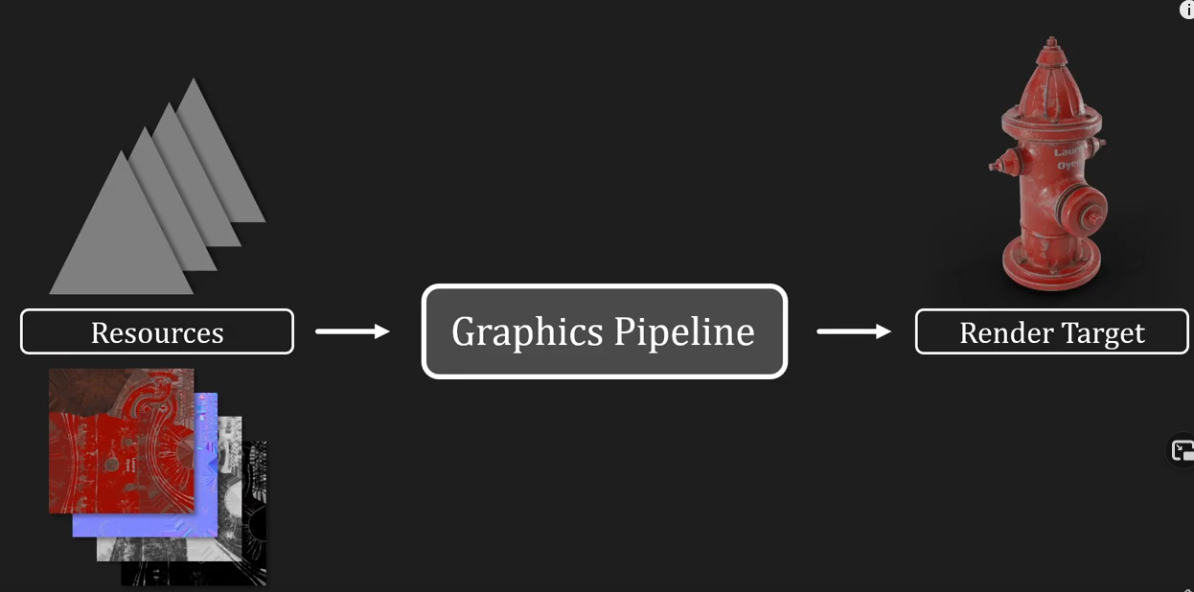
[Starting with the software will make it easier to understand the motivation behind the hardware.]
Notes:
Think of the graphics pipeline as a function that performs a bunch of transforms to a base set of data, given some parameters for those functions and some input data, and spits out a ‘render target’, which is the 3D or 2D render of an object or image.

Slide 8
Let’s look at an example...
If I want to to multiply 4 numbers together:
GPU (Parallel Processing) vs CPU(Series Processing)
VS

Slide 9
Let’s dive a little more into how a GPU could parallelize its workload
Let’s start with a super simple example →
vector_a = [5.0, 6.0, 2.0, 0.0, 1.0]
vector_b = [0.0, 4.0, -1.0, 2.0, 1.0]
for i in range(len(vector_a)):
vector_c[i] = vector_a[i] + vector_b[i]
# what if instead of adding each cell of the vector with a for loop, in serial, we could add each cell in the vector in parallel?
# we could allocate a thread for every addition, and simply run all the threads in parallel?
Threads, blocks, cores, & SM’s
vA
vB
vC

Slide 10
Let’s dive a little deeper into today’s graphics pipeline and what it needs to do.

Slide 11
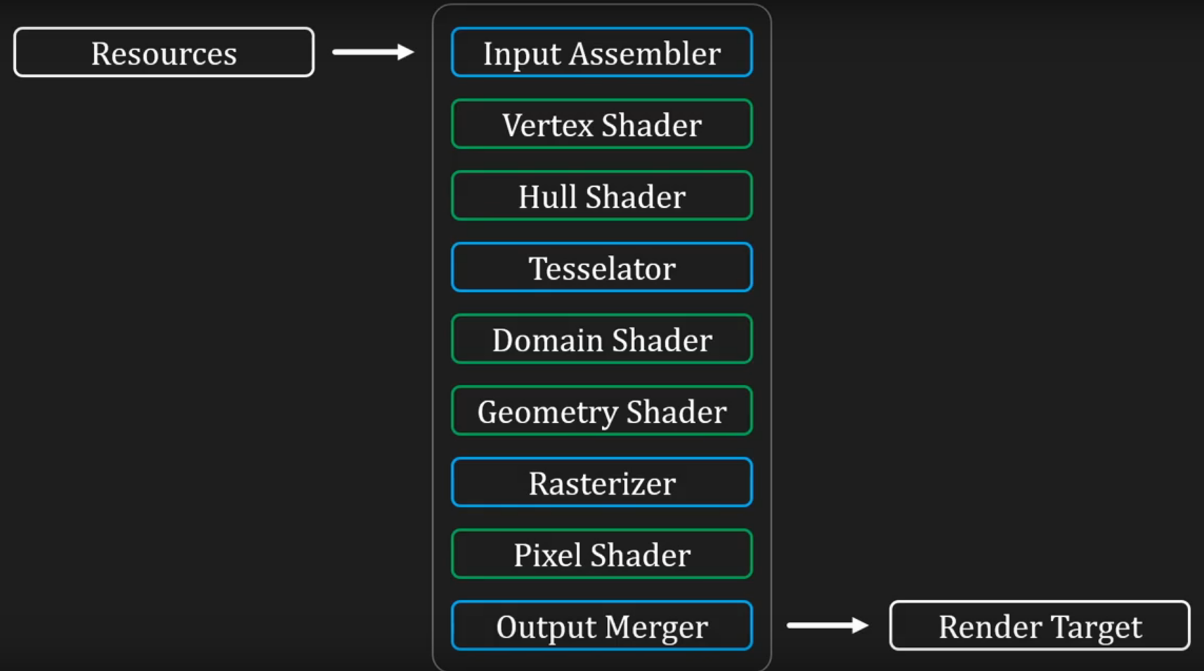
The Pipeline, expanded
Fixed function stages vs
shader stages
Minimal control vs
complete control
Notes:
This Graphics pipeline consists of a bunch of stages - fixed function stages, where we can change a few parameters, and shader stages, where we have full and complete control.

Slide 12
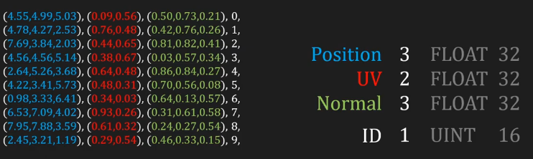
Buffers & Data
Every stage manipulates a key set of data stored in a buffer.
There are many buffers that serve different purposes →
This is the vertex buffer.
Notes:
[slide]
The graphics pipeline begins with the vertex buffer - a large chunk of data, comprised of a bunch of vertices that make up your triangles that make up your image. Each vertex is comprised of 3 floating point vectors.
Down later on in the graphics pipeline we see that this buffer will be manipulated - an example manipulation will be what happens in the next slide.

Slide 13
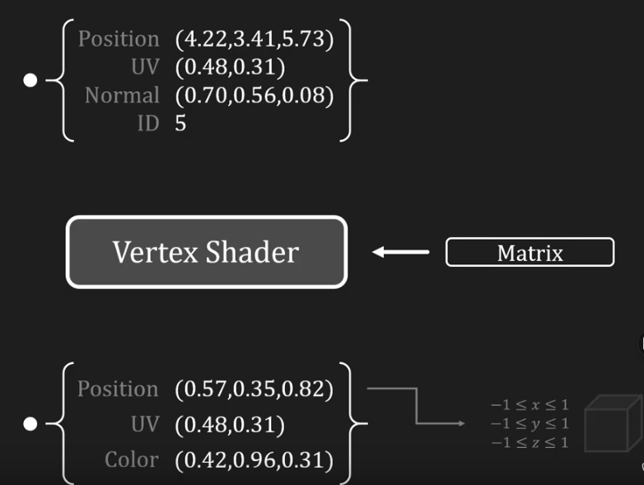
Buffer manipulation, or what happens at every stage of the pipeline, is just a lot of math.
Notes:
The vertex shader stage simply takes every vertex in the vertex buffer, and scales the positions into a cube of 2x2x2. It may also add an attribute to the data, like color, as we can see in this example, increasing the size of the buffer.
So it's just matrix math! But you can see how being able to do work in parallel, like adding the two vectors that we saw earlier, can help us significantly.

Slide 14

Another example of a useful buffer …
If there are multiple objects in a scene, how do you know which to render?
(Assume you can’t change the order of converting your triangles to pixels to display on screen)
Notes:
We use a depth buffer, which converts triangles to pixels, but darkens color of each pixel the closer you are to the camera (if you have a lower z value).
The closer the surface of the triangle to the camera, the darker it will be - and then we factor that into our final render.
So again, more matrix math, and now more data to store, too! But an interesting solution to the problem.

Slide 15


Slide 16
Now that we know what needs to happen, what kind of hardware needs to exist to support these operations?

Slide 17
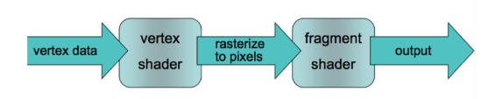
Hardware….
Back in the day, the hardware used to be a fixed function pipeline.
→ Programmers had very little control over how things got rendered.
→ Different hardware was used for different shaders |
→ The pipeline was based on the hardware config, not the users code.
2 API’s → OpenGL & DirectX
Notes:
To interact with the hardware, programmers would have to use 2 API’s -
OpenGL - more of a vendor spec to specify the hardware interface
DirectX - Microsoft’s software library for graphics, that as time went on became more flexible
Within early versions of OpenGL, users would only be able to specify certain matrices to fine tune the pipeline, as opposed to swapping out entire shaders.

Slide 18
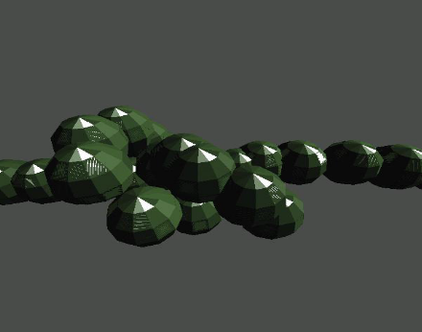

Because there was so little pipeline variation early on, graphics kinda looked the same too.

Slide 19
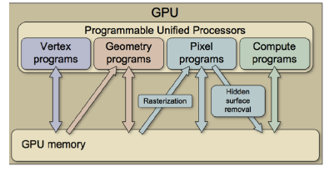
But things began to shift …
Today’s GPU’s use a shared GPU memory, and use programmable hardware cores that can do the job of any shader.
NVIDIA introduced CUDA, which allows programmers to use general purpose C code to interface with the thousands of cores on a GPU, to carry out parallel operations.

Slide 20
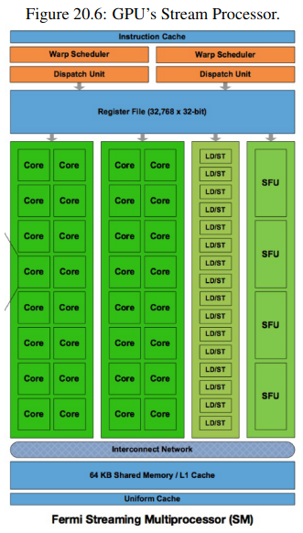
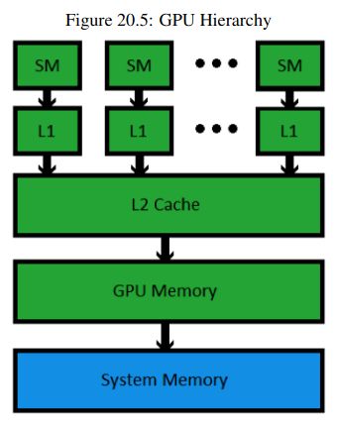
A little on GPU hardware

Slide 21
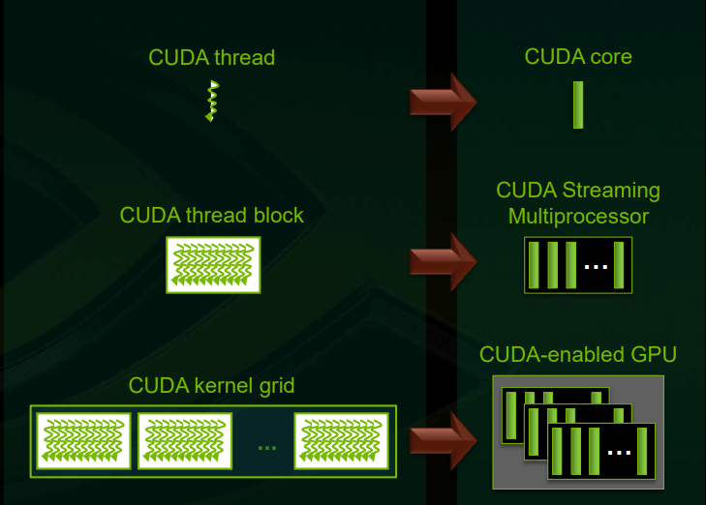
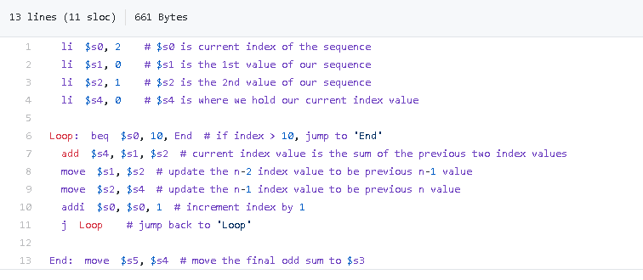
It starts with a thread…..
What is a thread exactly?
A thread the smallest sequence of programmed instructions that can be managed by a scheduler, eg:
Simple assembly code for a function(Fibonacci sequence, etc) can be considered a thread
What if I want to find the Fibonacci series, with different starting numbers?. What if I wanted to do a 100 of them at once: multiple threads

Slide 22
Threads are grouped into blocks ( collection of similar threads)
Blocks are grouped into grids ( collection of similar blocks)
Since each execution flow (thread) is run by a core..
A collection of cores make up a streaming multiprocessor (running similar threads/ or a block)
A collection of streaming multiprocessors make up a CUDA enabled GPU (running similar blocks/or a grid)
A kernel is executed as a grid of blocks of threads

Slide 23
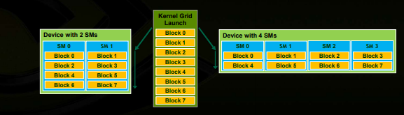
Why grouping into blocks?
They allow cooperation:
They can share results with each other
Cooperate to produce a single result (final thread), etc
They allow scalability:
Blocks can execute in any order
This independence between blocks gives scalability

Slide 24
Other google-able interesting terminology we didn’t cover
Ray-tracing
Projection
Rasterization
Approximating your triangles onto the limited pixel based resolution of your monitor.
Pixel shading -
How textures & color gets applied to your shapes and objects!

Slide 25
Connecting up & out
Where might you see crossovers to what we covered today in your everyday engineering life?
Ofc, game dev!
How does 3D modeling work? @CAD?
VFX, animation!

Slide 26
Activity - Custom hardware for the pipeline stage!
Team up in groups of 3 / 4. (breakout rooms if needed). You make up the lead architects for a secret batch of custom GPU hardware. Take a look at the pixel shader (or a graphics pipeline stage of your choice), and figure out how custom hardware for that stage would look.
Don’t forget about - memory management! [25 minutes]
Notes:
This is hard AF

Slide 27
GPU day 2

Slide 28
Somewhere along the line …
People realized that GPU’s can do more than render graphics. GPU computation is …

Slide 29
Photo Editing
Photoshop and Premiere Pro, have a large number of specialized filters that require high-level mathematics.
The rendering time for large images or video streams can be completed faster by using the GPU to offload calculations.
Some people may notice no difference, while others see large time gains depending upon what tasks they use and the graphics card they use.

Slide 30
Accelerating Video
High-def videos require decoding of compressed data to produce high-res images.
Both ATI and NVIDIA developed software that lets the GPU handle this decoding.
The graphics card helps transcode the video from one graphics format to another.
Taking one format and re-rendering it in another format uses a lot of computing power, so the GPU helps out.

Slide 31
SETI@Home
SETI@Home is a computer application that allows the Search for Extra-Terrestrial Intelligence project to analyze radio signals.
This program uses the advanced calculating engines within the GPU allow it to accelerate the amount of data processed in a given period of time compared to the use of only the CPU.
SETI@Home can do this with NVIDIA graphics cards by using CUDA (Compute Unified Device Architecture, a specialized version of C code that can access NVIDIA GPUs).

Slide 32
Cryptocurrency Mining
The standard method of acquiring virtual currencies is through a process called “cryptocoin mining”.
In it, you use your computer as a relay for processing computation hashes for dealing with transactions.
A CPU can do this at one level. However, a GPU on a graphics card offers a faster method. As a result, a PC with a GPU can generate currency faster than one without it.

Slide 33
OpenCL
OpenCL (Open Computer Language) specifications have been the most noteworthy development in the use of graphics cards for additional performance.
This specification pulls together a variety of specialized computer processors in addition to a GPU and CPU for accelerating computing.
All sorts of applications can potentially benefit from using a mix of different processors to increase the amount of data that's processed.

Slide 34
Let’s now take a look at CUDA.
Cuda is a || computing platform designed for heterogeneous systems (a system with a GPU, CPU, and RAM, etc.). GPU’s can be used for accelerated computation.

Slide 35
Part 1 - thread hierarchy

Slide 36
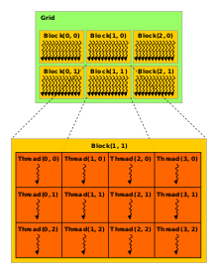
Let’s talk more about threads, and how they’re organized
Threads can be grouped to make up blocks.
Blocks can be grouped to make up grids.
A kernel executes as a Grid of blocks of threads.
You would use a Kernel for …

Slide 37
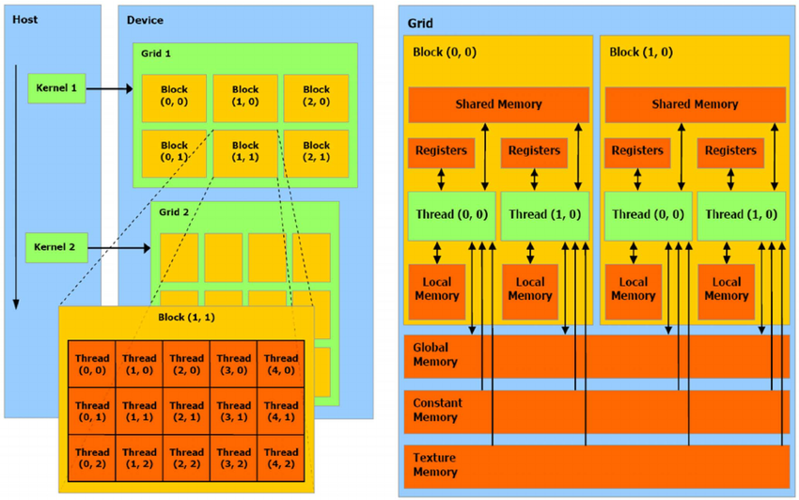
Running Computations That Supplement CPU Software
A single kernel is launched from the CPU and is executed in multiple threads on the GPU
Threads can be organized in 3D structures named blocks which can be organized in 3D grids.
The dimensions of blocks and grids are explicitly defined by the programmer.
This is a schematic representation of CUDA threads and memory hierarchy.

Slide 38
Part 2 - the memory model

Slide 39
Another Look At The Architecture
Threads can access data from many different memories with different scopes
Registers and local memories are private for each thread.
Shared memory lets threads belonging to the same block communicate, and has low access latency.
All threads can access the global memory, which suffers of high latencies but is cached since the introduction of Fermi architecture.
Texture and constant memories can be read from any thread and feature a cache as well.
This is a schematic representation of CUDA threads and memory hierarchy.

Slide 40
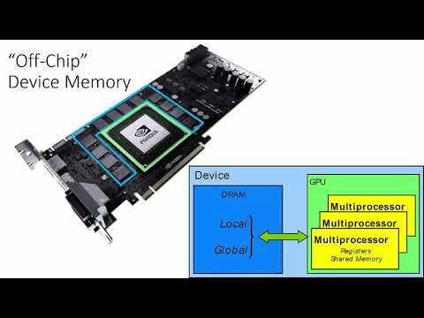
How are the results of the parallel computations stored and accessed?
Important Terms:
CUDA Cores
Streaming Multiprocessors (SM’s)

Slide 41
CUDA (2006)

Slide 42
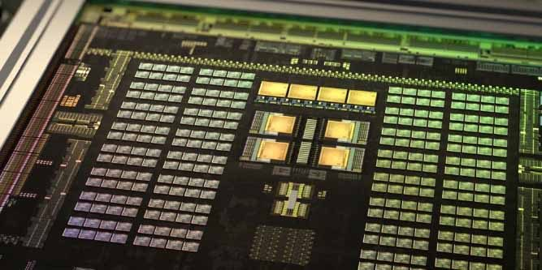
CUDA Cores
A small part of the larger whole when it comes to an Nvidia GPU.
A "CUDA Core" is Nvidia's equivalent to AMD's "Stream Processors."
CUDA Cores are parallel processors (similar to CPU cores), with Nvidia GPUs hosting several hundred or thousand cores.
The cores are responsible for processing all the data that is fed into and out of the GPU, performing calculations that are resolved visually to the end-user.

Slide 43
CUDA Cores cont.
Each GPU can contain hundreds to thousands of CUDA cores. Architecture changes in a fashion that makes cross-generation comparisons often non-linear, but generally speaking (within a generation), more CUDA cores will equate more raw compute power from the GPU.
The Kepler to Maxwell architecture jump saw nearly a 40% efficiency gain in CUDA core processing ability, illustrating the difficulty of linearly drawing comparisons without proper benchmarks.

Slide 44
Streaming Multiprocessors
Streaming Multiprocessors (SMs) are the part of the GPU that run CUDA kernels.
Each SM contains:
Thousands of registers that can be partitioned among threads of execution
Several caches for fast data interchange between threads, fast broadcast of reads from constant memory, etc.
Warp schedulers that can switch contexts between threads and issue instructions to warps that are ready to execute
Execution cores for integer and floating-point operations.

Slide 45
Streaming Multiprocessors cont.
There are several registers and context switches between threads to maximize the throughput of the hardware.
The GPU is designed to have enough state to cover both execution latency and the memory latency of hundreds of clock cycles that it may take for data from device memory to arrive after a read instruction is executed.
SMs target much lower clock rates, they support instruction-level parallelism, and they have less cache, but the computing power in a GPU makes up for these disadvantages.

Slide 46

CUDA and it’s Architecture laid the groundwork for other parallel computing platforms like OpenCL & OpenGL. Here we will just be looking at the big 2: CUDA vs. OpenCL

Slide 47
OpenCL vs CUDA
OpenCL is implemented by many vendors(intel,nvidia,amd,xilinx…), CUDA is only implemented by Nvidia
In terms of performance OpenCL and base level CUDA are comparable, but with optimizations CUDA is superior.
OpenCL has more spread out and documented support for possible architectures, whereas CUDA is more in-depth regarding the Nvidia environment.
OpenCL abstracts much of hardware away from developer, CUDA doesn’t abstract that much and lets developers optimize specifically for the underlying Nvidia architecture.
The learning curve for OpenCL is higher than it is for CUDA
Both can pipeline many kernels sequentially or in parallel and allow for the ability to re-define some compute resources of a device.

Slide 48
OpenCL vs CUDA
OpenCL doesn’t have enough libraries out-of-box and relies on the competence of the user to find the resources they need whereas CUDA comes out-of-box with several APIs.
OpenCL and CUDA have different copyrights.
CUDA is older (2006) as opposed to OpenCL (2009)
Both have fast addressable in-chip memory and both can spill private registers to global memory.
SPIR-V is base of OpenCL, LLVM is base of CUDA
CUDA can be used via the runtime API, which provides a C-like set of routines and extensions, and via the driver API, which is lower level towards the hardware but requires more code and programming effort.

Slide 49
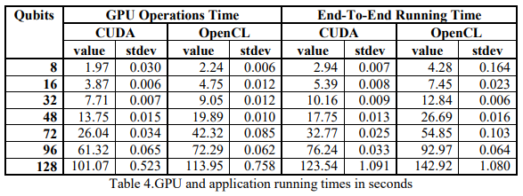
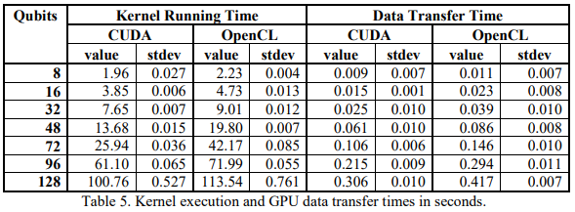
Running & Transfer times are faster for CUDA
OpenCL kernels can be compiled at runtime
CUDA kernels were developed by Nvidia which gives it the in-house advantage with hardware

Slide 50
Activity - Lobbyist Time!
Team up in groups of 3 / 4. (breakout rooms if needed). It’s 2010 and you need to come up with arguments as to why OpenCL or CUDA is superior for the current technical demands of the time. You will not know which side you will be representing so come up with arguments and counter arguments for each side.

Slide 51
Sources
https://arxiv.org/vc/arxiv/papers/1005/1005.2581v1.pdf
https://www.lifewire.com/graphics-cards-3d-graphics-834089
https://www.researchgate.net/figure/Schematization-of-CUDA-architecture-Schematic-representation-of-CUDA-threads-and-memory_fig1_261069154
https://www.gamersnexus.net/dictionary/2-cuda-cores#:~:text=CUDA%20Cores%20are%20parallel%20processors,visually%20to%20the%20end%2Duser.
https://www.informit.com/articles/article.aspx?p=2103809#:~:text=GPU%20Programming%2C%20The-,The%20streaming%20multiprocessors%20(SMs)%20are%20the%20part%20of%20the%20GPU,fast%20data%20interchange%20between%20threads
https://www.youtube.com/watch?v=OSpy-HoR0ac&feature=emb_logo
https://www.youtube.com/watch?v=Hxk2pSuJZxk&feature=emb_logo
https://www.quora.com/What-are-the-differences-between-using-CUDA-and-OpenCL-for-parallel-programming
https://medium.com/@stevenn.hansen/what-are-we-actually-doing-on-cuda-and-opencl-1020553bfcdb
http://download.nvidia.com/developer/cuda/seminar/TDCI_Arch.pdf
https://www.khronos.org/opencl/resources
https://docs.nvidia.com/cuda/

